Slide 1
STAT 504 – Network and Text Analytics Lecture 5: Visualization
By Dr. Ellie Small

Slide 2
Overview
Topics:
Review
Density and Sparsity
Special Graphs
Visualization
Wayne Zachary’s Karate Club

Slide 3
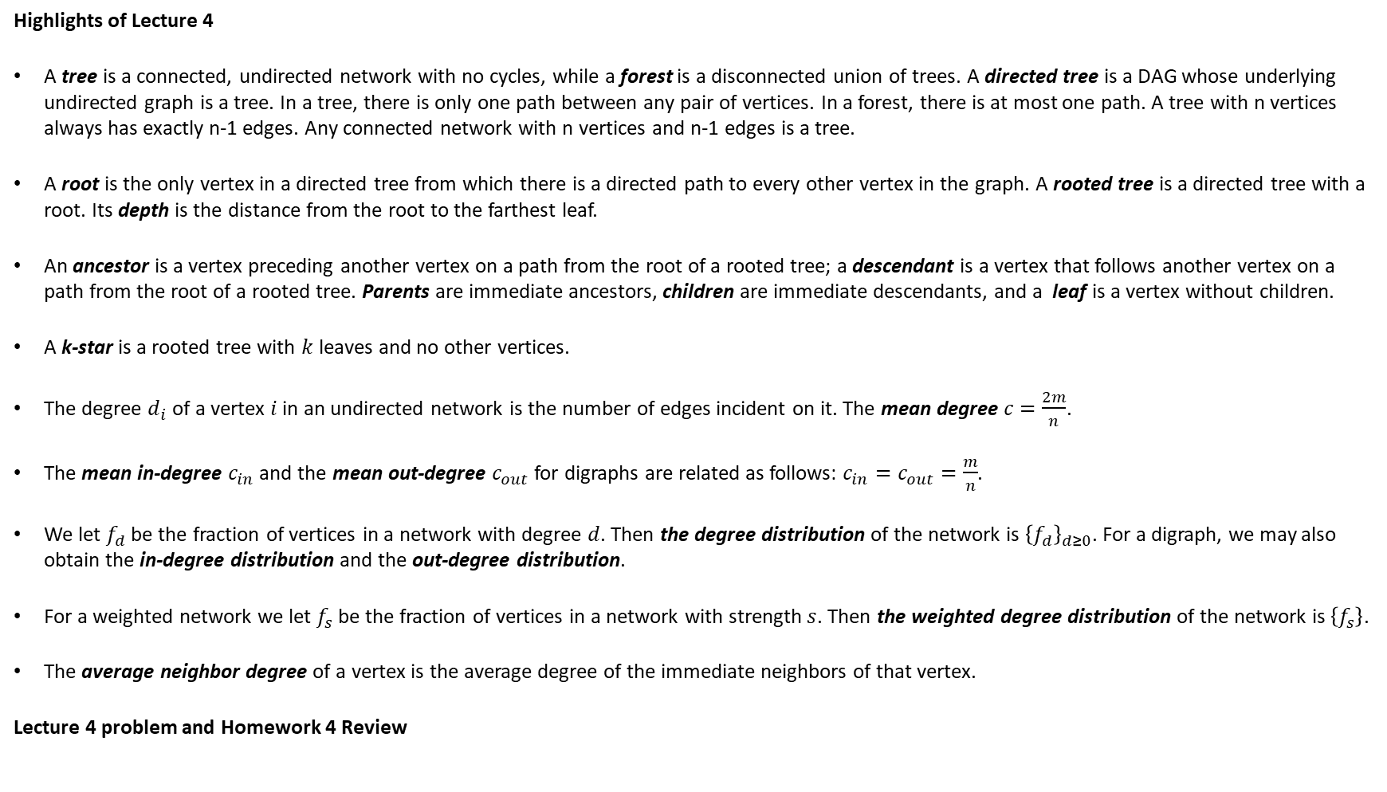
Review
Highlights of Lecture 4
A tree is a connected, undirected network with no cycles, while a forest is a disconnected union of trees. A directed tree is a DAG whose underlying undirected graph is a tree. In a tree, there is only one path between any pair of vertices. In a forest, there is at most one path. A tree with n vertices always has exactly n-1 edges. Any connected network with n vertices and n-1 edges is a tree.
A root is the only vertex in a directed tree from which there is a directed path to every other vertex in the graph. A rooted tree is a directed tree with a root. Its depth is the distance from the root to the farthest leaf.
An ancestor is a vertex preceding another vertex on a path from the root of a rooted tree; a descendant is a vertex that follows another vertex on a path from the root of a rooted tree. Parents are immediate ancestors, children are immediate descendants, and a leaf is a vertex without children.
A k-star is a rooted tree with $k$ leaves and no other vertices.
The degree $d_{i}$ of a vertex $i$ in an undirected network is the number of edges incident on it. The mean degree $c=\frac{2m}{n}$.
The mean in-degree $c_{in}$ and the mean out-degree $c_{out}$for digraphs are related as follows: $c_{in}=c_{out}=\frac{m}{n}$.
We let $f_{d}$ be the fraction of vertices in a network with degree $d$. Then the degree distribution of the network is ${\left\{f_{d}\right\}}_{d≥0}$. For a digraph, we may also obtain the in-degree distribution and the out-degree distribution.
For a weighted network we let $f_{s}$ be the fraction of vertices in a network with strength $s$. Then the weighted degree distribution of the network is $\left\{f_{s}\right\}$.
The average neighbor degree of a vertex is the average degree of the immediate neighbors of that vertex.
Lecture 4 problem and Homework 4 Review

Slide 4
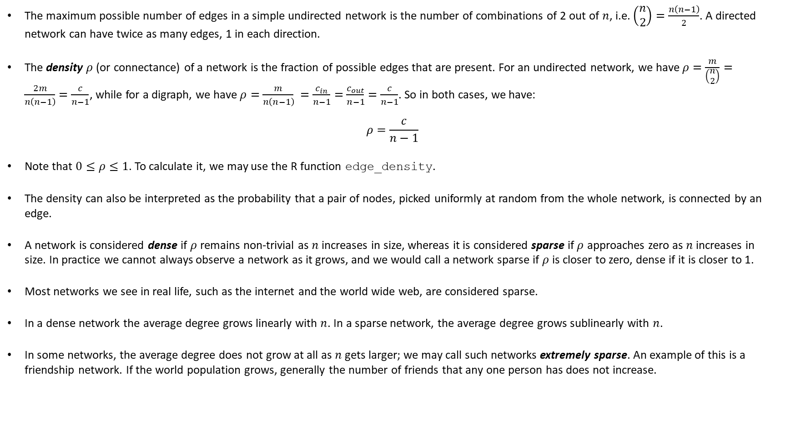
Density and Sparsity
The maximum possible number of edges in a simple undirected network is the number of combinations of 2 out of $n$, i.e. $\left(\begin{matrix}n \\ 2\end{matrix}\right)=\frac{n\left(n−1\right)}{2}$. A directed network can have twice as many edges, 1 in each direction.
The density $ρ$ (or connectance) of a network is the fraction of possible edges that are present. For an undirected network, we have $ρ=\frac{m}{\left(\begin{matrix}n \\ 2\end{matrix}\right)}=\frac{2m}{n\left(n−1\right)}=\frac{c}{n−1}$, while for a digraph, we have $ρ=\frac{m}{n\left(n−1\right)} =\frac{c_{in}}{n−1}=\frac{c_{out}}{n−1}=\frac{c}{n−1}$. So in both cases, we have:
$$ρ=\frac{c}{n−1}$$
Note that $0≤ρ≤1$. To calculate it, we may use the R function edge_density.
The density can also be interpreted as the probability that a pair of nodes, picked uniformly at random from the whole network, is connected by an edge.
A network is considered dense if $ρ$ remains non-trivial as $n$ increases in size, whereas it is considered sparse if $ρ$ approaches zero as $n$ increases in size. In practice we cannot always observe a network as it grows, and we would call a network sparse if $ρ$ is closer to zero, dense if it is closer to 1.
Most networks we see in real life, such as the internet and the world wide web, are considered sparse.
In a dense network the average degree grows linearly with $n$. In a sparse network, the average degree grows sublinearly with $n$.
In some networks, the average degree does not grow at all as $n$ gets larger; we may call such networks extremely sparse. An example of this is a friendship network. If the world population grows, generally the number of friends that any one person has does not increase.

Slide 5
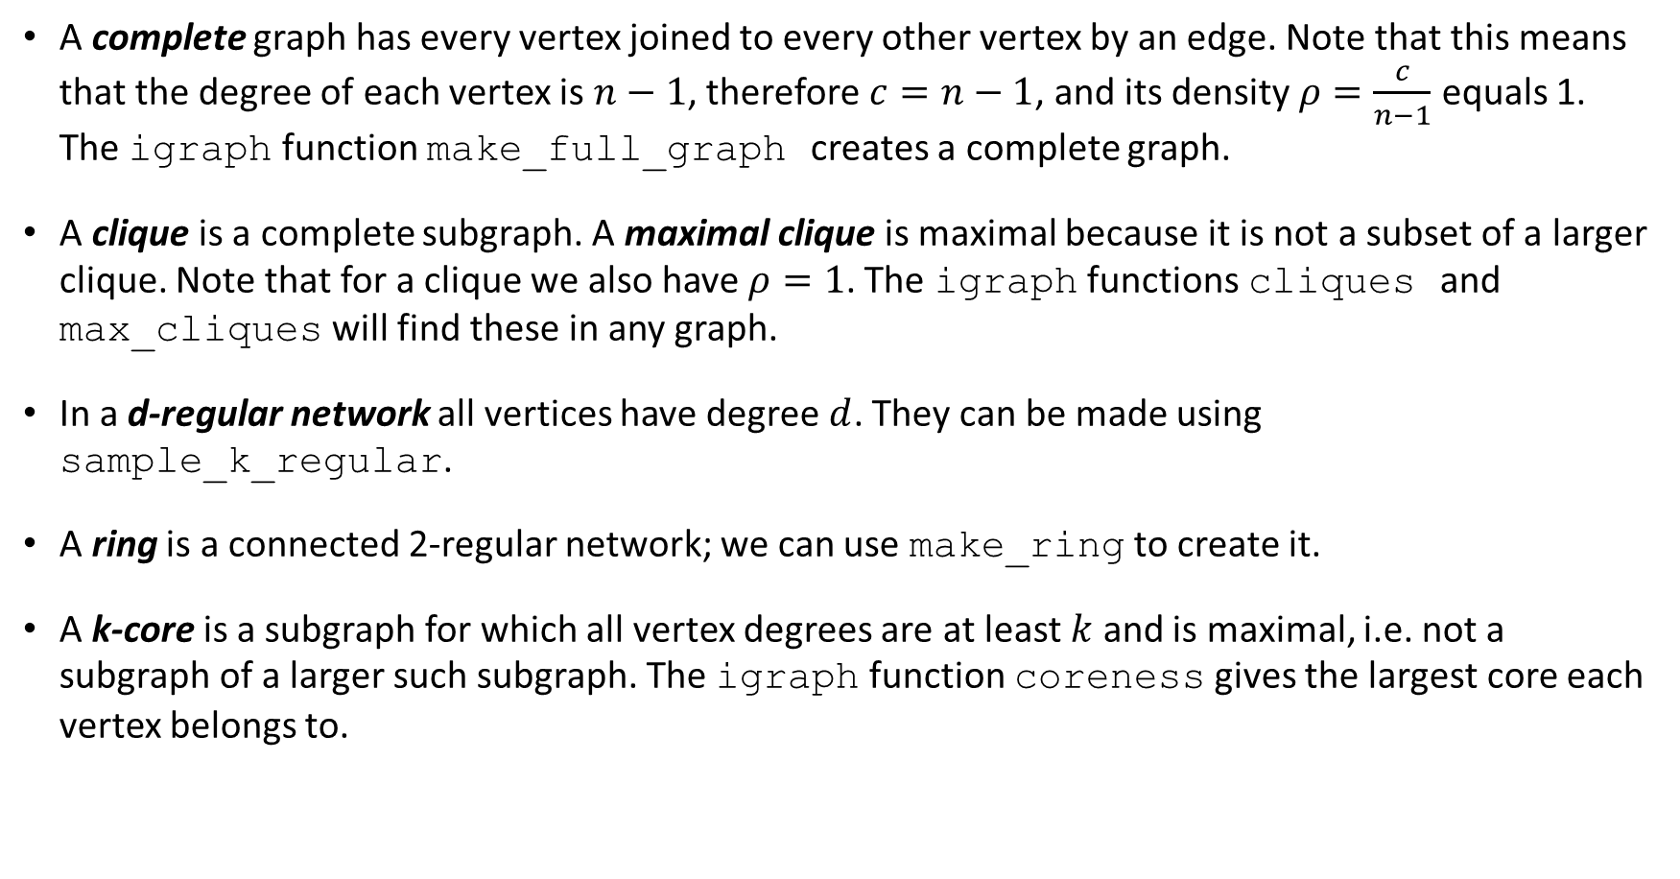
Special Graphs
A complete graph has every vertex joined to every other vertex by an edge. Note that this means that the degree of each vertex is $n−1$, therefore $c=n−1$, and its density $ρ=\frac{c}{n−1}$ equals 1. The igraph function make_full_graph creates a complete graph.
A clique is a complete subgraph. A maximal clique is maximal because it is not a subset of a larger clique. Note that for a clique we also have $ρ=1$. The igraph functions cliques and max_cliques will find these in any graph.
In a d-regular network all vertices have degree $d$. They can be made using sample_k_regular.
A ring is a connected 2-regular network; we can use make_ring to create it.
A k-core is a subgraph for which all vertex degrees are at least $k$ and is maximal, i.e. not a subgraph of a larger such subgraph. The igraph function coreness gives the largest core each vertex belongs to.

Slide 6
Visualization
The visualization of a network can be improved if we have additional information about the graph. We can plot it using a specific layout; we have already seen how this improves the visualization of trees and bipartite graphs.
There are many layouts; here is a small selection:
layout_as_bipartite
layout_as_tree
layout_in_circle
layout_with_fr (Fruchterman/Reingold)
layout_with_kk (Kamada/Kawai)
For some layouts such as the circle layout, the ordering of the vertices in the graph is important; it can make the difference between a visually pleasing layout and a mess.
NOTE: A lattice is a regular geometric arrangement of points (vertices) over an area in space. We can create a lattice graph using make_lattice.

Slide 7
Visualization - 2
Using ?igraph.plotting we have already seen how we can change plots of graphs with respect to shape and color of vertices, size of arrow heads and color of edges, etc.
There are three ways we can affect the items displayed in ?igraph.plotting:
Overall, using igraph_options, which sets the values for the current RStudio session or until replaced by another igraph_options call.
As attributes of a graph, using vectors that will apply each value to specific vertices/edges, which will then be used whenever the graph is plotted.
As options in a plot statement, using vectors that will apply each value to specific vertices/edges and will only be used for that particular plot.
NOTE: Higher numbers in this list take precedence, so colors set in a plot statement override colors set in the graph, which in turn override colors set using igraph_options.
For a decorated graph, we can use the information present in the decoration of the graph to make its depiction more visually attractive using these settings.

Slide 8
Wayne W. Zachary’s Karate Club
Recall that the vertices in the network of Zachary’s karate club represent members of the club, while each edge indicates a social interaction between two of the members. During the two years that Zachary was there, the club split into two factions due to a dispute between the head teacher and the administrator/president.
In the graph, the head teacher is identified by the name “Mr Hi”, while the president is identified by the name “John A”. All other members are identified as numbered actors.
A vertex attribute (Faction) indicates the faction the members eventually split into.
The edge attribute weight indicates the relative frequency of interactions between members.
More information about this data set can be obtained by typing ?karate into R.
We continue decorating the graph using the user-defined attributes. The vertex names are too long, so for the labels we remove the word “Actor” and just use the numbers.

Slide 9
Wayne Zachary’s Karate Club - 2
We create the vertex attribute shape, which we set to a rectangle for Mr. Hi and John A, and a circle for everyone else.
We create the vertex attribute color, setting everyone in faction 1 to red, and everyone in faction 2 to seagreen.
We set the vertex attribute frame.color to black.
We calculate the strength of each vertex, and create the vertex attribute size based on that. We also create the vertex attribute size2, which has an effect only on the rectangle shapes.
We use the edge attribute weight to create the edge attribute width.
We set the edge attribute color depending on the faction of the vertices connected by the edge: pink when both vertices are in faction 1, palegreen when both are in faction 2, and black for edges between the two factions.
We create the vertex attribute label.dist which offsets the label away from the vertex; we set it to 0.75 for any small vertices (size less than 7), and to the default 0 for all others.

Slide 10
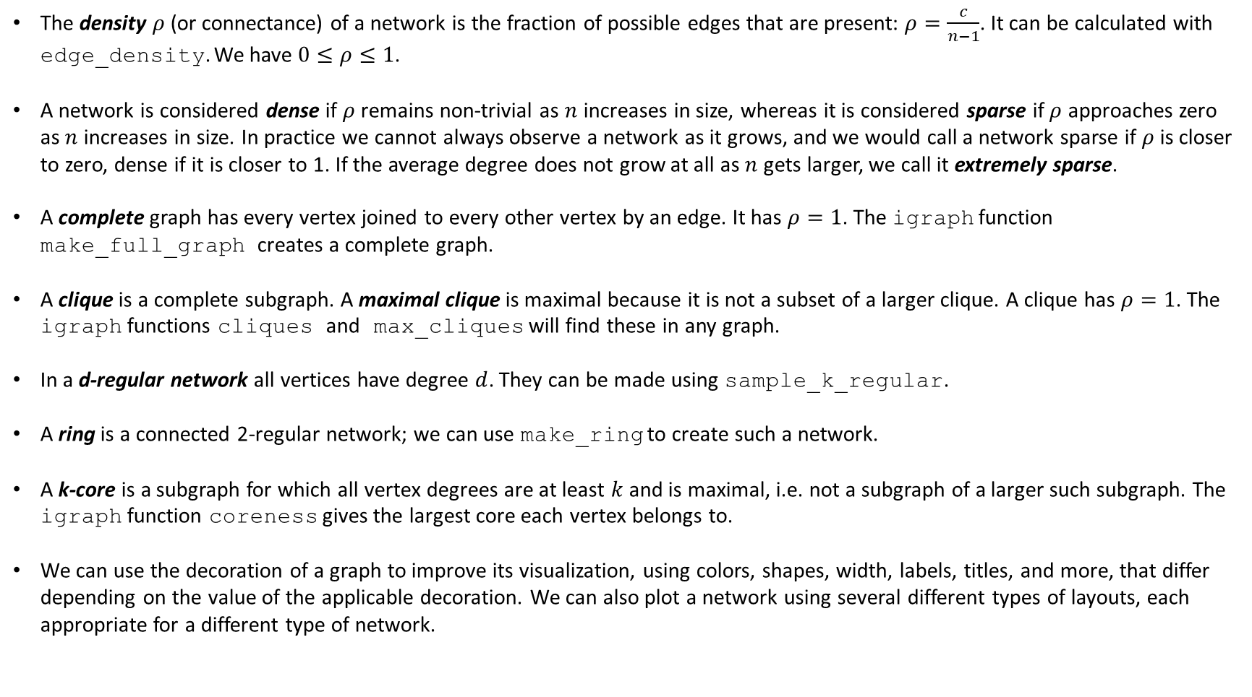
Today’s Summary
The density $ρ$ (or connectance) of a network is the fraction of possible edges that are present: $ρ=\frac{c}{n−1}$. It can be calculated with edge_density. We have $0≤ρ≤1$.
A network is considered dense if $ρ$ remains non-trivial as $n$ increases in size, whereas it is considered sparse if $ρ$ approaches zero as $n$ increases in size. In practice we cannot always observe a network as it grows, and we would call a network sparse if $ρ$ is closer to zero, dense if it is closer to 1. If the average degree does not grow at all as $n$ gets larger, we call it extremely sparse.
A complete graph has every vertex joined to every other vertex by an edge. It has $ρ=1$. The igraph function make_full_graph creates a complete graph.
A clique is a complete subgraph. A maximal clique is maximal because it is not a subset of a larger clique. A clique has $ρ=1$. The igraph functions cliques and max_cliques will find these in any graph.
In a d-regular network all vertices have degree $d$. They can be made using sample_k_regular.
A ring is a connected 2-regular network; we can use make_ring to create such a network.
A k-core is a subgraph for which all vertex degrees are at least $k$ and is maximal, i.e. not a subgraph of a larger such subgraph. The igraph function coreness gives the largest core each vertex belongs to.
We can use the decoration of a graph to improve its visualization, using colors, shapes, width, labels, titles, and more, that differ depending on the value of the applicable decoration. We can also plot a network using several different types of layouts, each appropriate for a different type of network.

